Slide 1
Secure Your Windows Kiosks and Workstations

Slide 2





Chris Sires
Adam Nichols
Sr. Product Manager & former SCCM dev
Senior Product Manager
@sirescreek
mauvlan
@mauvlan

Slide 3
Session learning objectives
Secure Through Zero Trust Methodologies
What is this everyone is saying Zero Trust!
Tools to Secure your Kiosks
Our Experiences!
Assigned Access in Windows 10 / 11
How to build Assigned Access Profiles
Tools to Deploy Assigned Access
Notes:
Jeff

Slide 4
Security

Slide 5
What is Zero Trust!
Security for a world without boundaries
To trust, you must first verify (Verify Explicitly)
Use least privileged access
Assume breach
Zero Trust Model - Modern Security Architecture | Microsoft Security
Signal → Decision → Enforcement
Notes:
Zero Trust Model - Modern Security Architecture | Microsoft Security
https://www.microsoft.com/en-us/security/business/zero-trust#:~:text=Microsoft%20has%20adopted%20a%20Zero%20Trust%20strategy%20to,health%2C%20and%20least-privilege%20access%20to%20resources%20and%20services.
Examples to Do what NOT TO DO

Slide 6
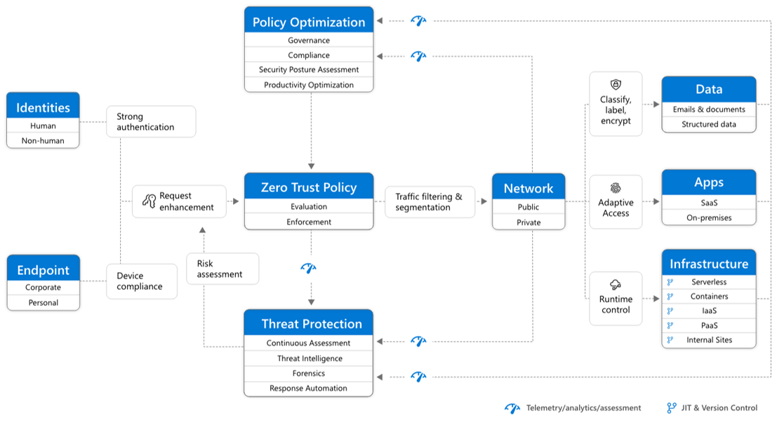
Notes:
Multiple Layers Needed
Device Management
Intune Compliance
Antivirus Antimalware
EDR
Network isolation
Identity Protection / Access Control
Conditional Access
Leave Little or No Trace

Slide 7
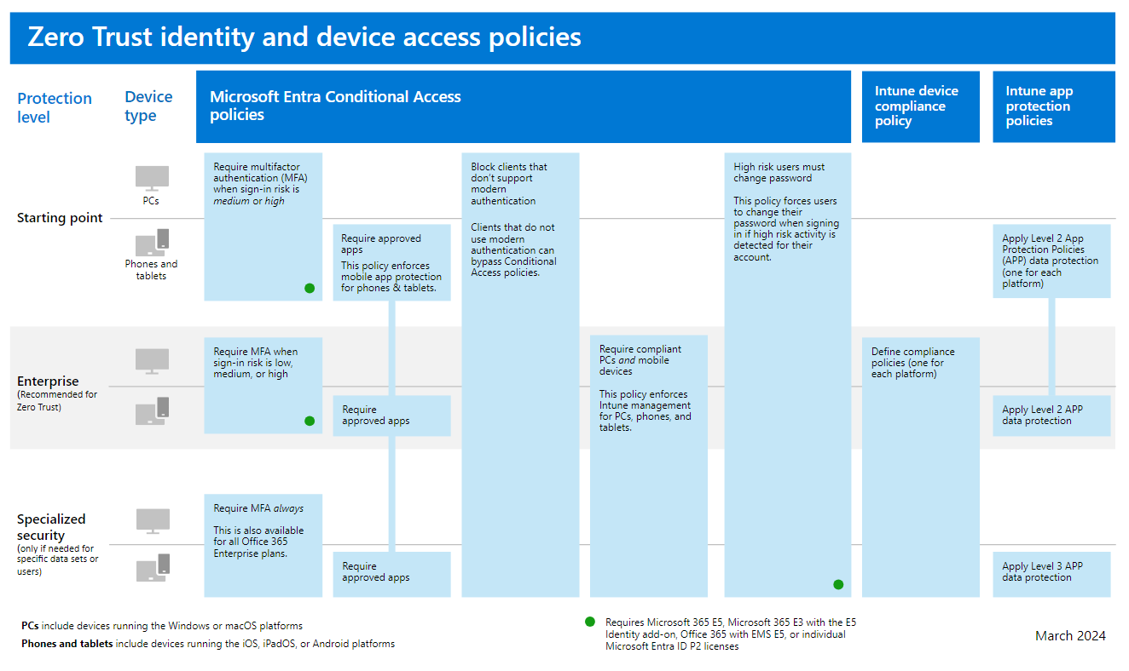
Notes:
Identity is the new Perimeter
Common Zero Trust identity and device access policies - Microsoft 365 for enterprise | Microsoft Learn

Slide 8
Recap Experiences
Only Use what You Need
Build to Be Lost
Limit Reused Identities
Automate Enrollment
Device Targeting

Slide 9
Kiosk

Slide 10
Some Kiosk Challenge
Finding effective methods to provide secure workstations.
Shell mod scripts.
Numerous GPOs.
Autologin accounts.
Difficult for multiuser workstations.
Challenges deploying in volume.
Complexity has limited adoption
App Locker policies can be frustrating.
Finding the right lockdown policies.
What do we need to block?
Notes:
Adam

Slide 11
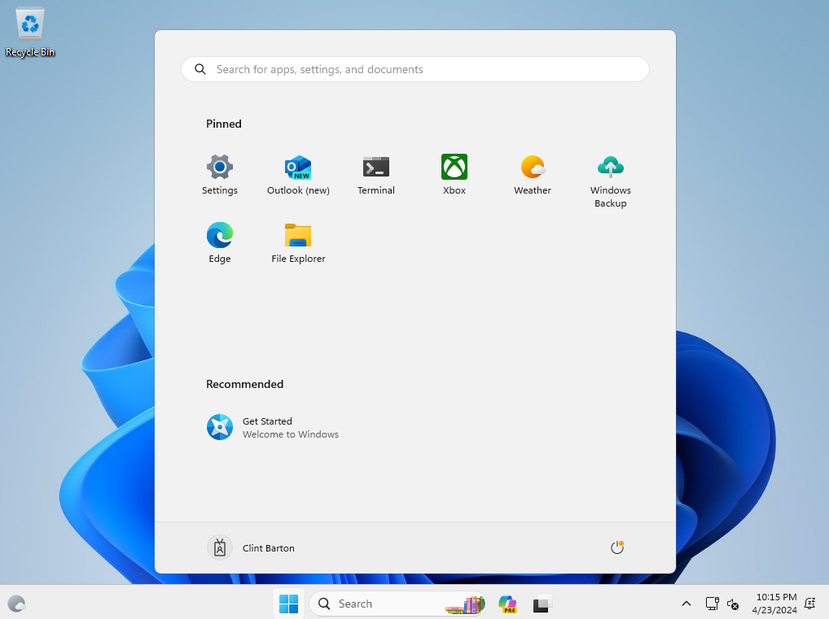
Overview of Assigned Access
Configured and delivered via XML.
Support for Win32 and Appx.
Support for multiple account types.
Explorer view restrictions available.
Support for Entra and AD join scenarios.
Notes:
Adam
Assigned access is a feature built into Windows 10 that allows end users and admins to create a lockdown environment. Allowing users to interact with only the applications predefined by the administrator.
Configure and delivered via single XML
Can target any Win32 or Appx application
Explorer view restrictions available
Can target multiple account types
Provides Support for AAD and AD Join Scenarios

Slide 12
Assigned Access Profile Types
Single Application
Targeting single app in full screen view.
Simple configuration.
Multi Application (Lockdown Mode)
Any situation looking to limit access to specific applications.
Provide only what the user needs and nothing more.
No configuration options for the end user.
Notes:
What is Assigned Access? - Configure Windows | Microsoft Learn
Adam
Single Application
Targeting single app in Full Screen View
Simple Configuration
Multi Application
Any Situation looking to limit access to specific applications
Provide only what the user needs and nothing more
No configuration options for end user

Slide 13
Win 10 & 11 Differences
Windows 10 Full Screen Start (I love this mode)
Windows 11 more of a shared Desktop Feel
Pretty Much Everything is the Same!

Slide 14
Native Windows

Slide 15
Policy Bits
According to Brian

Slide 16
Delivery Mechanisms
Native UX
Intune Ui
MDM Bridge (PowerShell)
Demo – Custom CSP Intune
Demo – Intune Policy

Slide 17
Demo – Custom CSP Intune

Slide 18
Intune - Custom CSP

Slide 19
Intune Policy
According to Brian

Slide 20
Trouble Shooting

Slide 21
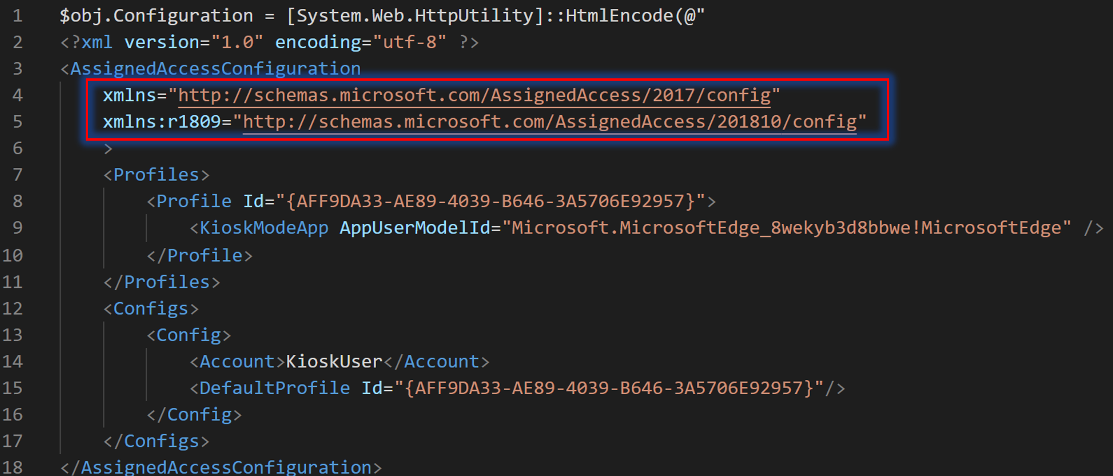
Troubleshooting
XML Formatting
Use examples.
Be aware of versioning.
Edit in VS Code.

Slide 22
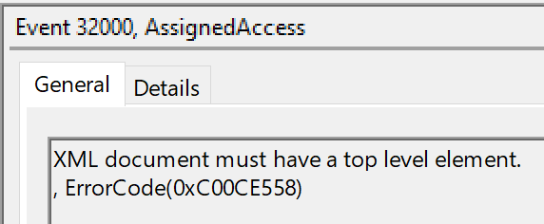
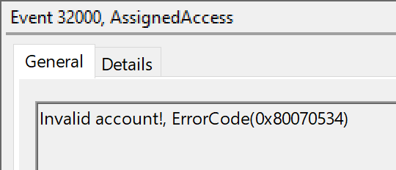
Troubleshooting
Chained Executables
All executables need to be defined or they will FAIL!
Use Process Explorer for assistance
App locker
Leverage Event viewer
Notes:
Split slides

Slide 23
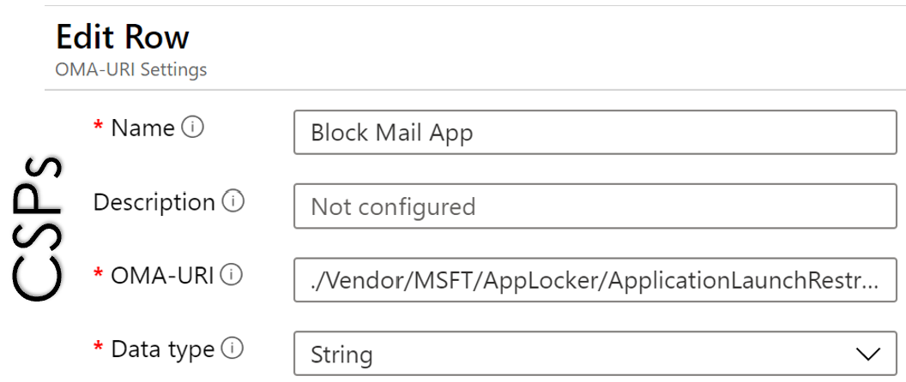
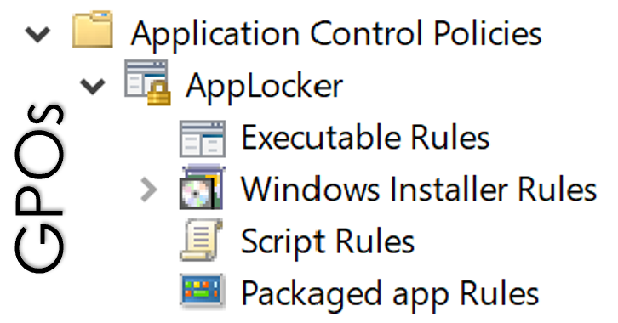
Troubleshooting
Understand External Conflicts
Group Policy
Configuration Items
Configuration Service Provider (CSPs)

Slide 26
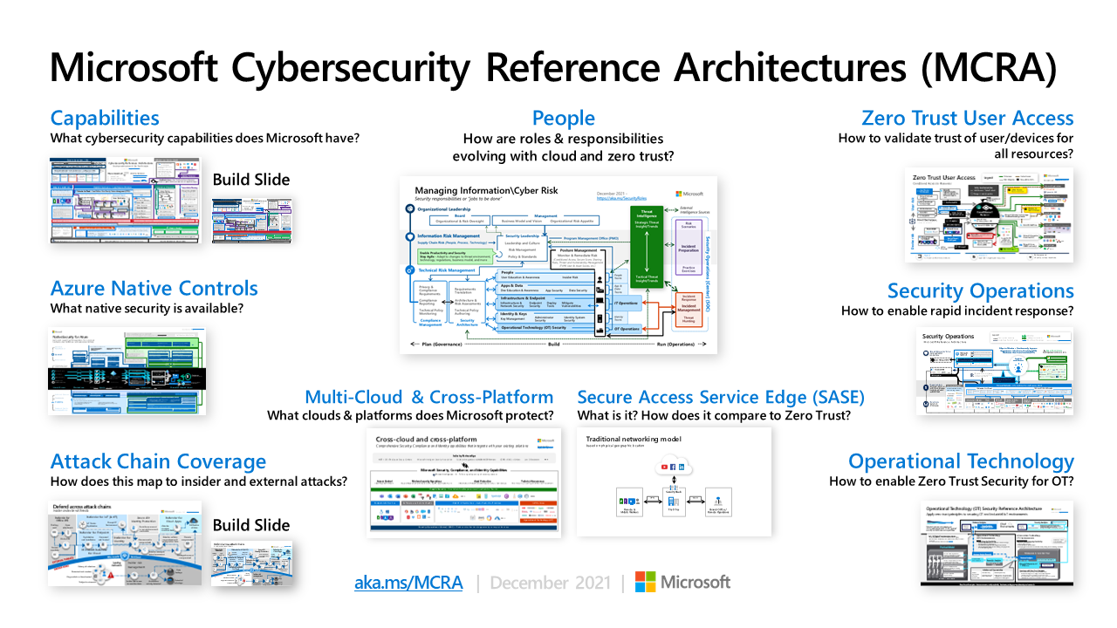
Microsoft Cybersecurity Reference Architectures - Security documentation | Microsoft Learn

